Slide 1
Standard Operating Procedures (SOPs) Monitoring & Supervision
Orientation on Monitoring and Supervisory System
Department of Health
Arshad Mahmood PhD
Deputy Chief of Party
Health Systems Strengthening Component
USAID’s MCH Program

Slide 2
Contents
Pre-requisites for SOPs of monitoring and supervision
Identification of health managers team for Monitoring and Supervision
Preparation of field visit plan
Conducting M&S visit
Reporting and providing Feedback

Slide 3
Pre-requisites for SOPs of monitoring and supervision
Dedicated health manager with the technical skills, knowledge and motivation to improve the quality of services;
Preparation of field visit plan;
Availability of monitoring tools, guidelines and protocols;
Resources required for monitoring and supervision;
Reporting and providing feedback to health facility staff and relevant DGHS staff.

Slide 4
1. Attributes of a Supervisor
Familiar with health care system;
Familiar with all health services (interventions) at each level as specified in the Essential Health Services Package
Ability to address both administrative and programmatic issues;
Committed, responsible and have strong interpersonal skills;
Ability to train, motivate and support supervisees;
Flexible, respectful and hardworking attitude.

Slide 5
2. Core Competencies of a Supervisor
Conceptual skills:
Ability to listen, probe and analyze situations, problems and formulate solutions;
Sufficient knowledge about health services and health system;
Interpersonal communication skills;
Ability to coach, train and convey information to others and learn from them;

Slide 6
………Core Competencies of a Supervisor
Sufficient knowledge of concepts of quality improvement (QI) including supportive supervision and the use of provincial guidelines and SOPs;
Ability to collect, analyze, visualize, interpret and provide feedback information/data
Deep understanding of the roles and responsibilities of supervisors
Ability to provide and receive feedbacks after each visit and write reports.

Slide 7
3. Training of Supervisors
Purpose of conducting monitoring and supportive supervision;
Communication and coaching skills;
Basic concept of quality, quality improvement (QI) and quality assurance (QA);
Roles and responsibilities of supervisors and mentors;
Practical of conducting supportive supervision including the use of tools, forms, charts and registers used in the health facilities; and

Slide 8
Quality of Health care
Quality health care can be simply defined as doing the right thing (getting the health care services you need), at the right time (when you need it), in the right way (using the appropriate test or procedure), to achieve the best possible results.

Slide 9
Health care quality can be defined by six attributes:
Safety - patients should not be harmed by the care that is intended to help them
Patient-Centered - care should be based on individual needs
Timely - waits and delays in care should be reduced
Effective - care should be evidence-based
Efficient - reduce waste
Equitable - care should be equal for all people

Slide 10
Potential Supervisors Team – District Level
District Health Officer
Deputy/Assistant District Health Officers
District DHIS Coordinator
Program Focal Persons of MNCH, LHW, EPI, Nutrition, TB, Malaria, Hepatitis, etc.
Any other position with special assignments such as, principal/ instructors of Nursing/public health schools

Slide 11
Potential Supervisors Team – Provincial Level
Director General Health Services
In-charge M&E Cell
Additional Secretary Technical/ Public Health, DOH.
Chief, HSRU
Provincial program heads and monitoring officers of MNCH, LHW, EPI, Nutrition, TB, Malaria, Hepatitis, etc.
Any other with special assignments such as, Director PHDC, principal/instructors of public health schools etc.

Slide 12
Preparation of field visit plan
A supervisory plan needs to have details about where and when to go, what to do and what to achieve;
Every month, managers will prepare Supervisory plan along with seeking their approval by the competent authority on monthly basis;
Supervisory teams will prepare monthly tour plans, rotating facility assignments with other health managers and supervisors based on competency areas;
DHO Office will prepare a consolidated district M&S tour plan using the approved tour plans of other supervisors;
The plans will be submitted to DGHS or uploaded online for approval.

Slide 13
Contents of the Plan
Date of the visits;
Name of the health facilities/outreach staff to be visited;
Purpose of the visits;
Tool(s) to be used during visits;
Review performance report of visiting facilities of previous three months.

Slide 14
Process of field visit plan
After the approval of the tour plan, the supervisor is expected to:
Join the supervisory team for the facility visit, but they may have a separate visit with prior DHO approval;
Share the visit plan with the health facilities and outreach workers beforehand as possible
Retain a copy of approved tour/visit plan during the visit;

Slide 15
Ensure availability of monitoring tools guidelines and protocols
Upon field visit approval, it is the responsibility of the health manager or supervisor to download relevant tools/checklists from web based M&E Dashboard so that it can be completed for each of the facilities to be visited;
This will help to plan the contents of the supervisory visit well in advance;

Slide 16
Resources needed for monitoring and supervision
Reliable transport;
Adequate time for preparation, travel, field visit, reporting and follow-up activities;
Travelling allowances;
Monitoring and supervisory tools; and
Support for periodic review meetings.

Slide 17
Conducting M&S visit
Show respect and patience throughout the supervisory visit;
Allow time for staff to complete any consultations underway and for any hand over;
Observe and gather information using the checklist as contained in tour plan;
The tool/checklist has to be filled completely according to the given user guidelines;
Mark evidence of monitoring visit as per standing instructions, like marking the visit in the attendance register of the facility, or in the LHW, CMW registers etc.;
Review the previous action points and status of implementation;

Slide 18
……Conducting M&S visit
Listen to their problems and challenges;
Address and follow up on problem areas;
Provide corrective and supportive feedback on performance;
In case a procedure is performed incorrectly, demonstrate the correct procedure and ask for return demonstration;
If there is a need, coordinate with mentors;
Update supervisees on new guidelines and information;
Give on-the-job training on new techniques and approaches, if required;

Slide 19
Immediate feedback
Once you are done with supervision, find a conducive environment with appropriate privacy to give feedback.
Use positive feedback, when performance is good; and constructive feedback, when performance needs improvement.
Start with those areas they are doing well followed by those where there are problems.
Focus on systems and processes, the performance or action, not on the person.
Discuss previous action points which were not implemented and include them in the new action plan;

Slide 20
……………Immediate feedback
Outline areas needing improvement and guide them to come up with corrective actions and time line;
Link the behavior to program goals e.g.
Listen attentively, with encouragement and open mind believing that everyone has good contributions to make;
Give a chance to the supervisee to respond.

Slide 21
Wrap up
Share new information, such as guidelines and training opportunities;
Share some observations/findings made such as data recording and reporting;
Summarize the specific aspects that require change or improvement, discuss/review and agree on what needs to be done and how;
Identify areas of strengths including specific aspects of care going well and commend them appropriately;

Slide 22
………..Wrap up
Identify areas that need improvement/ strengthening and agree on the action plan using a joint problem solving approach;
Set aside adequate time for supervisees’ questions;
Identify persons responsible to solve the identified action points and problem areas;
Share with staff as a group the supervisor’s general impressions on what is going well and what needs further improvement based on the supervisor’s findings;
When ready to leave, thank the supervisees and others.

Slide 23
Follow up and Feedback
Follow up on equipment and commodity supply problems in a timely manner with the district or provincial level authorities.
Give praise and recognition to health service providers for what they are doing right. Even if monetary recognition is not possible, recognition can be made in other forms. Health workers can be recognized through issuing appreciation letters or by awarding certificates for acknowledging good work.
Submit/upload online the report of monitoring visit to the competent authority within one week on the given format;

Slide 24
………..Follow up and Feedback
Upon receiving the visit report, the competent authority will:
Direct the supervisor regarding further actions that need to be taken within timeline;
Instruct the concerned focal person/ manager regarding the issues identified and actions required at their end;

Slide 25
………..Follow up and Feedback
In next visit monitor/supervisor should check/observe the follow up of actions of pervious visit (if any);
Present the consolidated monitoring and supervisory activity report of the district in the quarterly DHPMT meeting for decision making for resolution of issues, where required;
DHO will share the written feedback of monitoring visits to the DPWO, district manager (DM) PPHI if any other actions required at other stakeholder’s level.
Submit monitoring and supervisory activity report to the DG Health/M&E Cell at DGHS Sindh Office.

Slide 26
………..Follow up and Feedback
Present the monitoring and supervisory activity report in the quarterly provincial review meeting at DGHS Sindh Office. The presentation will include:
Implementation of planned visits, total visits planned, visits conducted and reasons if any visit could not be carried out;
Actions taken at district level;
Summary of issues identified for low performance;
Issues that could not be resolved at district level with proposed support required from provincial level to solve the identified problems;
Issues which need DGHS attention for implementation.

Slide 27
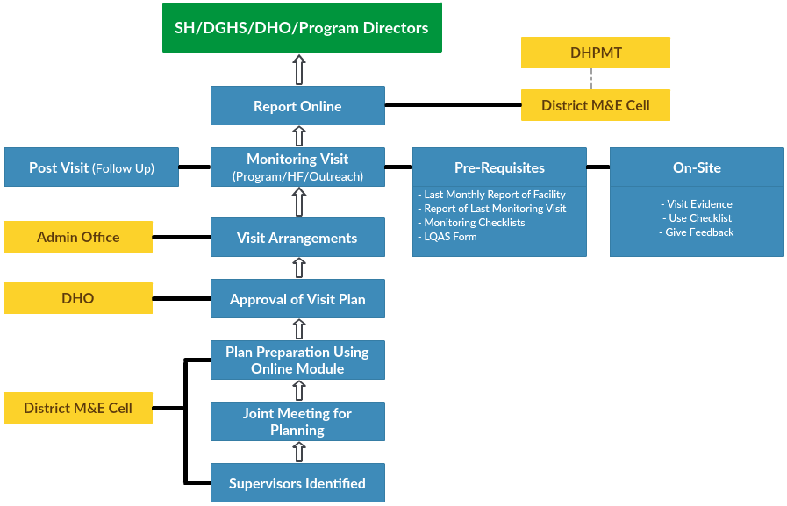

Slide 28
Thank You

